Slide 1


Slide 2
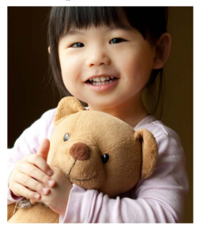
This Is
My Bear

Slide 3
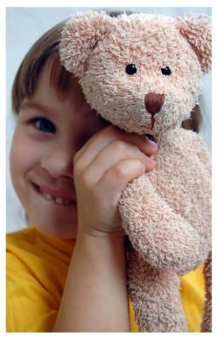
This is my bear.

Slide 4
Click to discover what makes this teddy bear special.
soft
fur
fat
feet
brown
ears

Slide 5
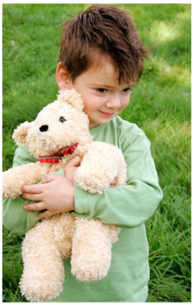
My bear is
soft.
return

Slide 6
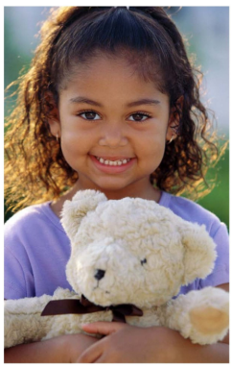
My bear has
fur.
return

Slide 7
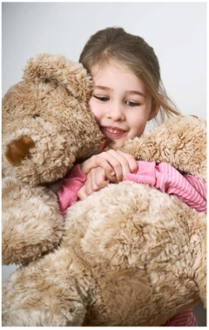
My bear is
fat .
return

Slide 8
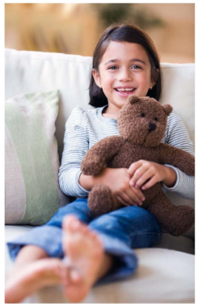
My bear is brown.
return

Slide 9
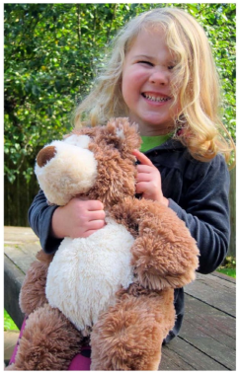
My bear has ears.
return

Slide 10
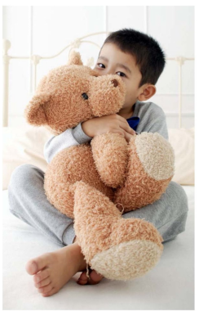
My bear has feet.
return

Slide 11
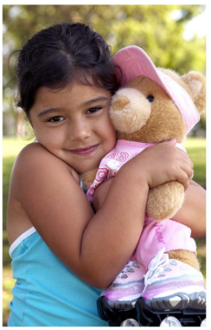
I love my bear.

